Slide 1
From Last Time
Light:
  Made from changing electric and fields
  A wave with all the typical wave properties
Modern Physics: Relativity
Physics changed drastically in the early 1900’s
Relativity one of the new discoveries
  Changed the way we think about space and time
  Relativistic effects seen with very fast moving objects and very massive objects. Astronomical objects

Slide 2
Galilean relativity
Absolute velocity not clear, but we can seemingly agree on relative velocities.
  In all cases the ball moves 40 mph faster than I do.
Examples of two different reference frames
  On the bus
  Off the bus
In both cases we could talk about
  the forces I put on the ball,
  the acceleration of the ball, etc

Slide 3
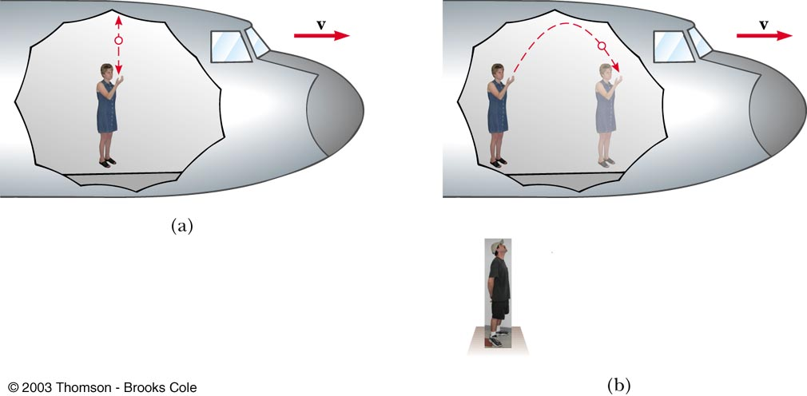
Example of Galilean relativity
Experiment may look different to different observers, but both agree that Newton’s laws hold
  Can make observations agree by incorporating relative velocities of frames.
Observer in plane
Observer on ground

Slide 4
Galilean relativity: example
Experiment performed…
  in laboratory at rest with respect to earth’s surface
  in airplane moving at constant velocity
  …must give the same result.
v=0
v>0
In both cases, ball is observed to rise up and return to thrower’s hand
  Process measured to take same time in both experiments
  Newton’s laws can be used to calculate motion in both.

Slide 5
Newton’s laws in moving frames
In both cases,
the acceleration of the ball is the same.
This is because the two reference frames move at a constant relative velocity.
Newton’s laws hold for each observer.
Which is good, because we apparently can’t determine our absolute velocity,
or even if we are moving at all!
This is an example of Galilean Relativity

Slide 6
Turning this around…
No experiment using the laws of mechanics can determine if a frame of reference is moving at zero velocity or at a constant velocity.
Concept of absolute motion is not meaningful.
  There is no ‘preferred’ reference frame
Inertial Frame:
reference frame moving in straight line
with constant speed.

Slide 7
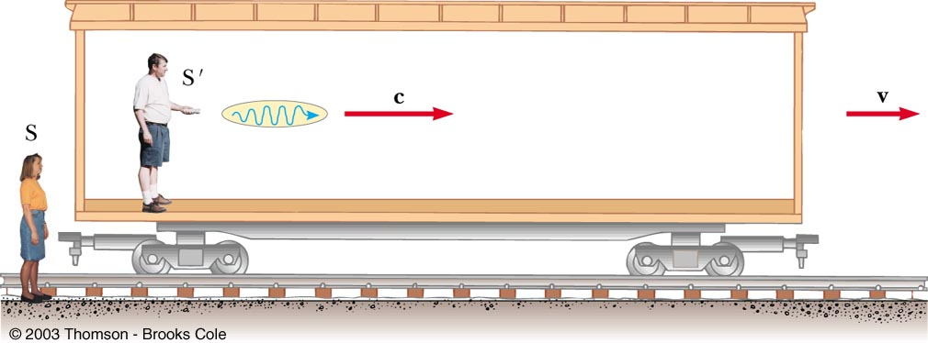
What about electromagnetism?
Maxwell equations say that
  Light moves at constant speed c=3x10⁸ m/sec in vacuum
Seems at odds with Galilean relativity:
Joe
Jane
  Jane would expect to see light pulse propagate at c+v
  But Maxwell says it should propagate at c, if physics is same in all inertial reference frames.
  If it is different for Joe and Jane, then in which frame is it c?

Slide 8
The Ether
To resolve this, 19th century researchers postulated existence of medium in which light propagates, rather than vacuum.
  i.e. similar to gas in which sound waves propagate or water in which water waves propagate.
Then Maxwell’s equations hold in the ether
Pluses | Minuses
Allows speed of light to be different in different frames (Maxwell’s eqns hold in frame at rest with respect to ether). | Ether must be rigid, massless medium, with no effect on planetary motion
Light then becomes like other classical waves, | No experimental measurement has ever detected presence of ether
Ether is absolute reference frame.

Slide 9
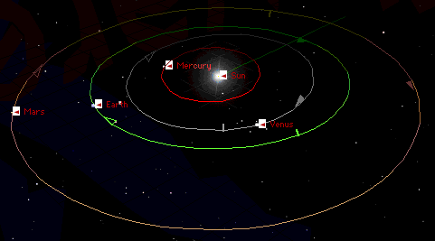
The Michelson-Morley experiment
If the earth moves thru a medium in which light moves at speed c, along the direction of the earth’s motion, light should appear from earth to move more slowly.

Slide 10
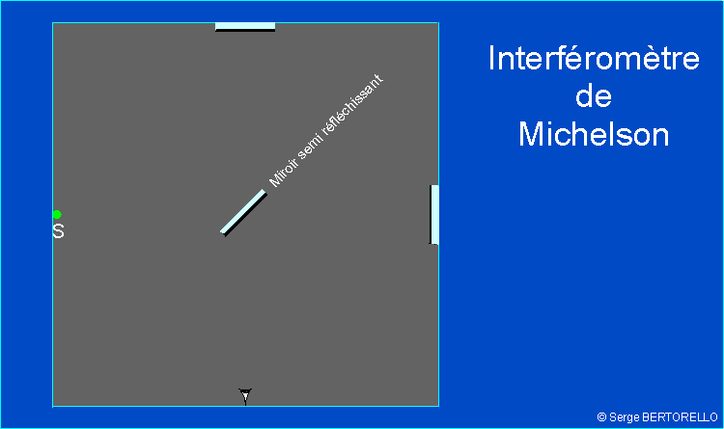
Ether wind would change average speed of light on the different paths.
Waves will interfere when they recombine.

Slide 11
Einstein’s principle of relativity
Principle of relativity:
  All the laws of physics are identical in all inertial reference frames.
Constancy of speed of light:
  Speed of light is same in all inertial frames
  (e.g. independent of velocity of observer, velocity of source emitting light)
(These two postulates are the basis of the special theory of relativity)

Slide 12
Simultaneity with sound
Suppose you hear two loud shots
about 1/2 second apart.
Did they occur at the same time?
Let’s think about it
Suppose you find out one of the shots was fired closer to you than the other.
Sound travels at 340 m/s.
If one gun were fired 170m closer to you then they were fired at the same time.

Slide 13
Simultaneity
If you know your distance from the shots, you can easily determine if they were simultaneous.
And everyone will agree with you, after doing the same correction for distance.
You might even come up with a definition
  Event (x₁, t₁) is simultaneous with event (x₂, t₂) if sound pulses emitted at t₁ from x₁ and at t₂ from x₂ arrive simultaneously at the midpoint between x₁ and x₂.
Einstein came up with a similar definition
for relativistic simultaneity.
  Due to the requirement of the consistency of speed of light not everyone agrees events are simultaneous

Slide 14
Consequences of Einstein’s relativity
Many ‘common sense’ results break down:
  Events simultaneous for observer in one reference frame not necessarily simultaneous in different reference frames.
  The distance between two objects is not absolute.
  Different for observers in different reference frames
  The time interval between events is not absolute.
  Different for observers in different inertial frames
Notes:
Doesn’t make sense to ask if two events occurred at the same time. The answer will be different for different observers. Also shouldn’t ask about the length of an object. It depends on who measures it. No right or wrong answer. Space and time are not the correct objects to measure.

Slide 15
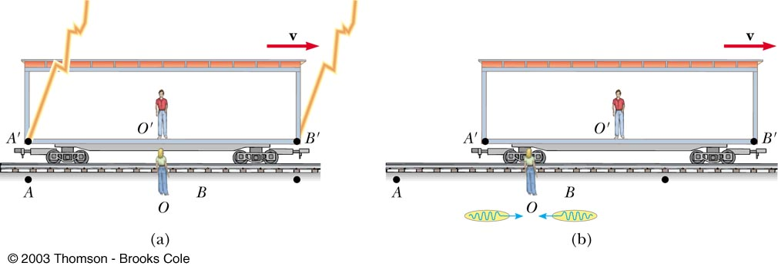
Simultaneity thought experiment
Boxcar moving with constant velocity v with respect to Jane standing on the ground.
Joe rides in exact center of the boxcar.
Two lightning bolts strike the ends of the boxcar, leaving marks on the boxcar and the ground underneath.
On the ground, Jane finds that she is halfway between the scorch marks.

Slide 16
Simultaneity, continued
Jane (on the ground) observes that light waves from each lightning strike at the boxcar ends reach her at exactly the same time.
Since each light wave traveled at c, and each traveled the same distance (since O is in the middle), the lightning strikes are simultaneous in the frame of ground observer.

Slide 17
When do the flashes reach Joe?
Jane can see when the two flashes reach Joe on the boxcar.
When light from front flash reaches Joe,
he has moved away from rear flash.
  —Front and rear flashes reach Joe at different times
Since speed of light always constant
Joe is equidistant from lightning strikes
—Joe is equidistant from the lightning strikes
—Light flashes arrive at different times
—Both flashes travel at c
Therefore for Joe, lightning strikes are not simultaneous.

Slide 18
Simultaneity and relativity, cont
Means there is no universal, or absolute time.
  The time interval between events in one reference frame is generally different than the interval measured in a different frame.
  Events measured to be simultaneous in one frame are in general not simultaneous in a second frame moving relative to the first.
  Has other consequences for time

Slide 19
Ether again
If there were an ether, this wouldn’t be a problem.
The ether would be the medium that transmits EM waves.
Speed of light is c relative to the ether.
Suppose ether stationary with respect to Jane on ground.
Joe sees the flash from the front of the train first because he is rushing towards it. The ether is rushing backwards, carrying the flash along with it. The train observer measures the wave from the front to travel faster than from the back.
After accounting for this,
he agrees with Jane that the strikes were simultaneous.

Slide 20
But there is no ether
No stationary ether, no absolute reference frame.
Joe sees that the train is stationary,
and that Jane is rushing backwards.
Joe sees the light pulses from the front and rear travel at exactly the same speed.
Since the flashes arrive at different times,
and Joe is equidistant between them, Joe concludes that the flashes occurred at different times.

Slide 21
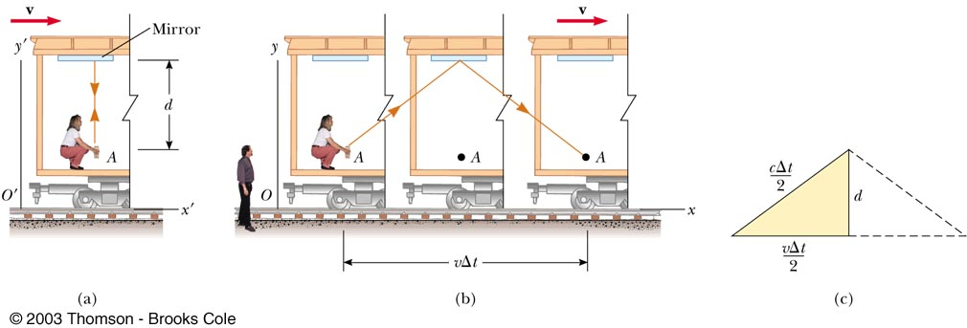
Time dilation
Reference frame of observer O’ on train
Reference frame of observer O on ground
Observer O on ground
Observer O’ on train moving at v relative to O
Pulse of light emitted from laser, reflected from mirror, arrives back at laser after some time interval.
Lets figure out what this time interval is for the two observers

Slide 22
Time dilation, continued
Reference frame of observer O’ on train
Reference frame of observer O on ground
Observer O’ on train: light pulse travels distance 2d.
Observer O on ground: light pulse travels farther
Relativity: light travels at velocity c in both frames
  Therefore time interval between the two events
  (pulse emission from laser & pulse return)
  is longer for stationary observer
This is time dilation

Slide 23
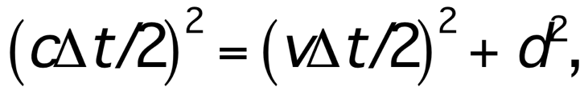
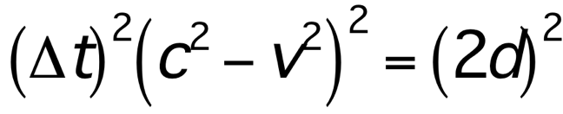
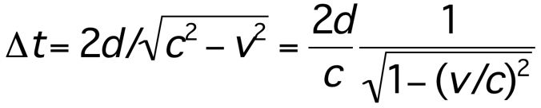
How large an effect is time dilation?
Δt = time interval between events in frame O (observer on ground)
Δt satisfies

Slide 24
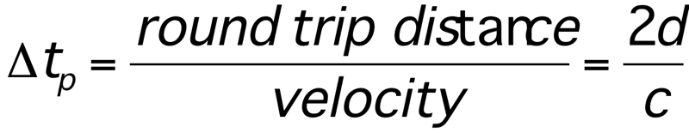
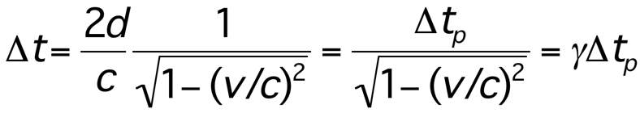
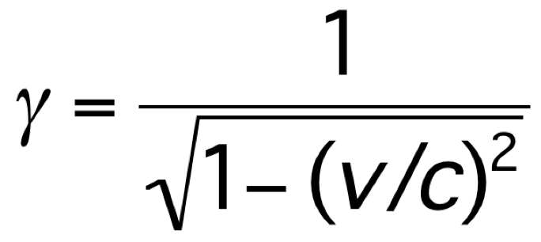
Time dilation
Time interval in boxcar frame O’
Time interval in ground frame O

Slide 25
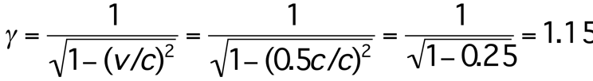
Example
Suppose observer on train (at rest with respect to laser and mirror) measures round trip time to be one second.
Observer O on ground is moving at 0.5c with respect to laser/mirror.
Observer O measures 1.15 seconds

Slide 26
Which way does time dilation go?
The shortest time measured between events is in the frame in which the events occur at the same spatial location.
This is called the ‘proper time’ between events, Δt_{p}
Example: The two events could be
1) Minute hand on clock points at ‘3’
2) Minute hand on clock points at ‘4’
In the rest frame of the clock, these occur at the same spatial location, and the time interval is 5 minutes.
In frame moving with respect to clock, time interval is γ(5 min)
To this observer, clock is moving, and is measured to run slow by factor γ⁻¹

Slide 27
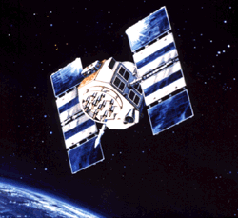
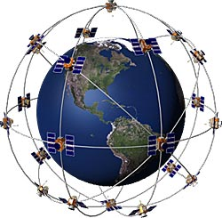
Special Relativity: GPS
GPS satellites have atomic clocks accurate to 1 nanosecond (one billionth of a second)
Positions computed by comparing time signals from several satellites.
Satellites moving at 14,000km/hr
Special Relativity: Clocks run slow by 7000ns per day!

Slide 28

The ‘proper time’
We are concerned with two time intervals.
Intervals between two events.
  A single observer compares time intervals measured in different reference frames.
If the events are at the same spatial location in one of the frames…
  The time interval measured in this frame
  is called the ‘proper time’.
  The time interval measured in a frame moving with respect to this one will be longer by a factor of γ

Slide 29
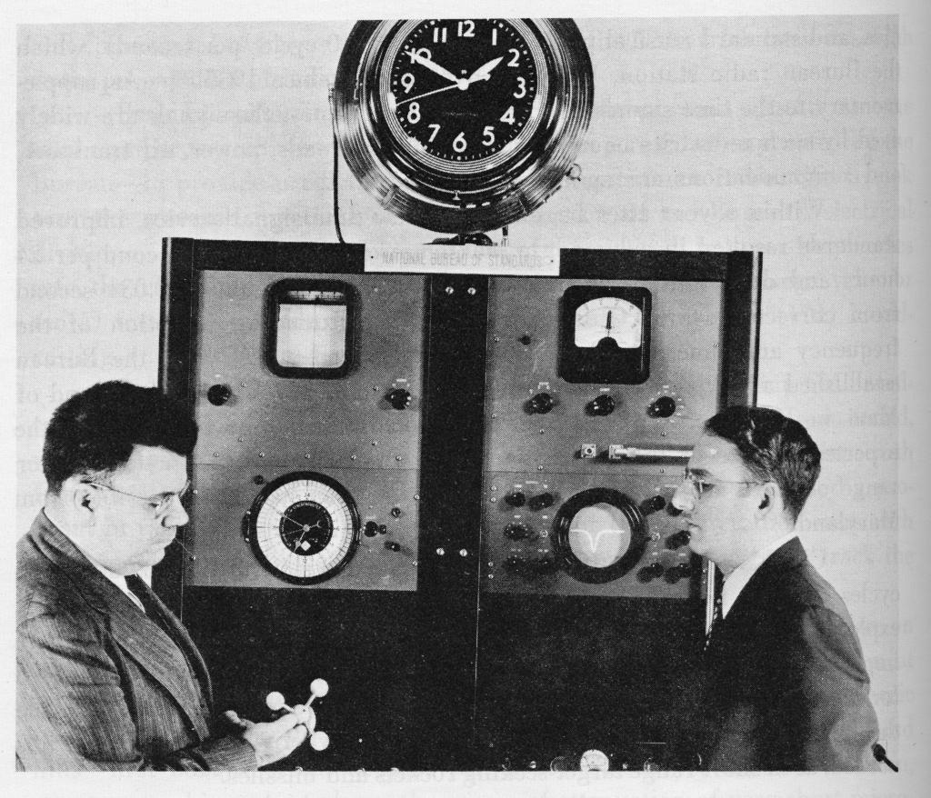
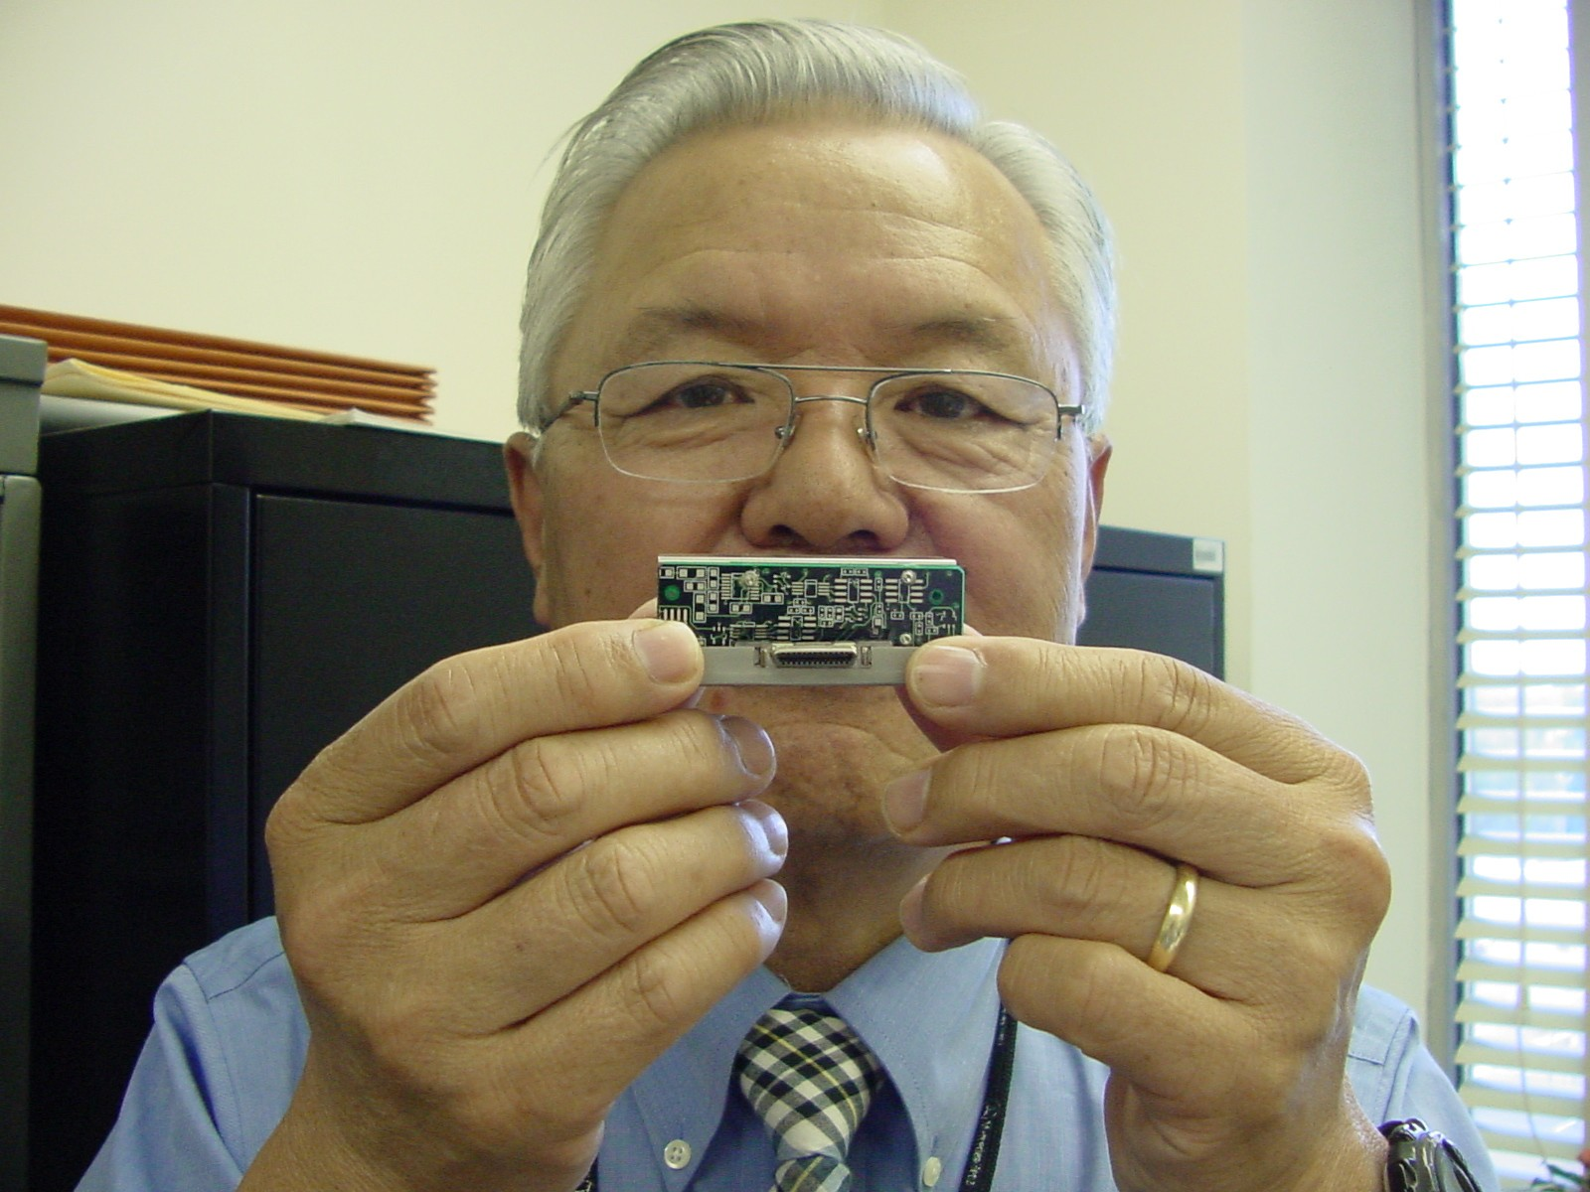
Atomic clocks and relativity
In 1971, four atomic clocks were flown around the world
on commercial jets.
2 went east, 2 went west -> a relative speed ~ 1000 mi/hr.
On return, average time difference was 0.15 microseconds, consistent with relativity.
First atomic clock: 1949
Miniature atomic clock: 2003

Slide 30
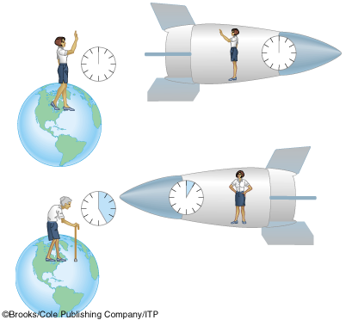

Traveling to the stars
Spaceship leaves Earth, travels at 0.95c
0.95c
d=4.3 light-years
Spaceship later arrives at star
0.95c

Slide 31
The ship observer’s frame
Earth leaves…
d=4.3 light-years
0.95c
..then star arrives
0.95c

Slide 32

Comparing the measurements
The ship observer measures ‘proper time’
  Heartbeats occur at the same spatial location
  (in the astronaut’s chest).
On his own clock, astronaut measures his normal heart-rate of
1 second between each beat.
Earth observer measures, with his earth clock, a time much longer than the astronaut’s ( Δt_{earth} = γ Δt_{astronaut} )
Earth observer sees astronaut’s heart beating slow,
and the astronaut’s clock running slow.
Earth observer measures 3.2 sec between heartbeats of astronaut.

Slide 33
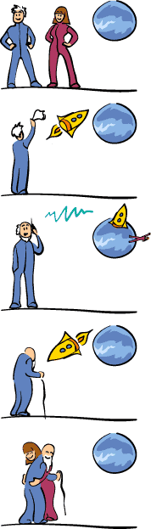
The twin ‘paradox’
The Earth observer sees the astronaut age more slowly than himself.
  On returning, the astronaut would be younger than the earthling.
  And the effect gets more dramatic with increasing speed!
  All this has been verified - the ‘paradox’ arises when we take the astronaut’s point of view.

Slide 34
Special relativity predicts that astronaut would disagree, saying earthling is younger!
Why?
d=4.3 light-years
0.95c
If both measure the time interval between heartbeats of the earthling, the earthling measures the proper time.
Any other measurement of the time interval is longer!
The astronaut says the earthling’s heart beats more slowly.
Apparently a direct contradiction.

Slide 35
Resolution
Special relativity applies only to
reference frames moving at constant speed.
To turn around and come back, the astronaut must accelerate over a short interval.
Only the Earthling’s determination of the time intervals using special relativity are correct.
General relativity applies to accelerating reference frames, and will make the measurements agree.

Slide 36
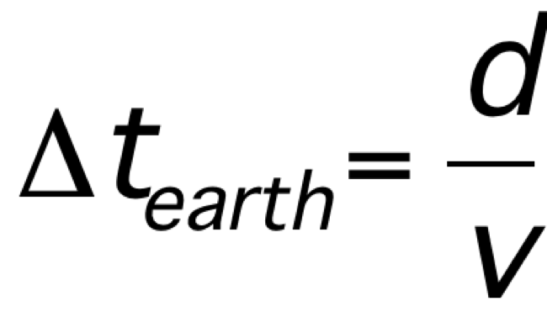

Total trip time
Spaceship leaves Earth, travels at 0.95c
0.95c
d=4.3 light-years
Time for astronaut passes more slowly by a factor gamma.
Trip time for astronaut is 4.5 yrs/3.2 = 1.4 years

Slide 37
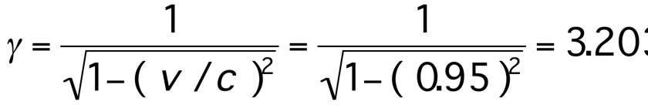
Relative velocity of reference frames
Both observers agree on relative speed,
hence also gamma.
Speed of light
v
Rocket frame
Earth frame
v

Slide 38
Are there other ‘paradoxes’?
Both observer’s agree on the speed (0.95c)
  Earth observer: ship moving
  Ship observer: earth and star moving
  They both agree on the speed
But they disagree about the total trip time.
If the time intervals are different, and speed is the same, how can distances be the same?
The distances are not the same!
Length contraction

Slide 39
Length Contraction
People on ship and on earth agree on relative velocity v = 0.95 c.
But they disagree on the time (4.5 vs 1.4 years).
What about the distance between the planets?
Earth frame d_{earth} = v t_{Earth}
= .95 (3x10⁸ m/s) (4.5 years)
= 4x10¹⁶m (4.3 light years)
Ship frame d_{ship} = v t_{ship}
= .95 (3x10⁸ m/s) (1.4 years)
= 1.25x10¹⁶m (1.3 light years)

Slide 40
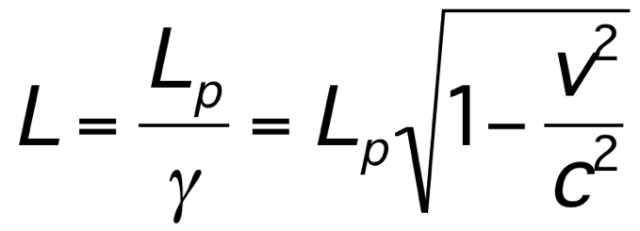
Length contraction and proper length
Which one is correct?
  Just like time intervals,
  distances are different in different frames.
  There is no preferred frame,
  so one is no more correct than the other.
The ‘proper length’ L_{p} is the length measured in a frame at rest with respect to objects
  Here the objects are Earth and star.
Length in moving frame
Length in object’s rest frame

Slide 41
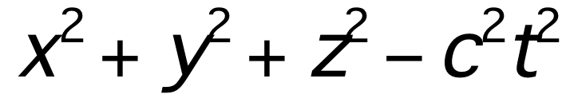
The real ‘distance’ between events
Is any measurement
the same for all observers?
Need a quantity that is the same for all observers
A quantity all observers agree on is
Need to look at separation both in space and time to get the full ‘distance’ between events.
In 4D: 3 space + 1 time
The same or ‘invariant’ in any inertial frame

Slide 42
Events in the Earth Frame
Event #1: leave earth
0.95c
d=4.3 light-years (LY)
Event #2: arrive star
0.95c

Slide 43
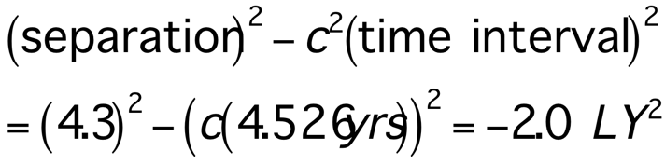
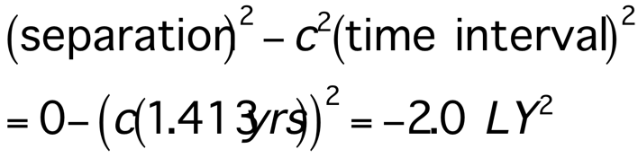
A relativistic invariant quantity
Earth Frame | Ship Frame
Event separation = 4.3 LY | Event separation = 0 LY
Time interval = 4.526 yrs | Time interval = 1.413 yrs
The quantity (separation)²-c²(time interval)² is the same for all observers
It mixes the space and time coordinates

Slide 44
Time dilation, length contraction
t= γ t_{proper}
  t_{proper} measured in frame where events occur at same spatial location
L=L_{proper} / γ
  L_{proper} measured in frame where events are simultaneous
γ always bigger than 1
increases as v increases
would be infinite for v=c
Suggests some limitation on velocity as we approach speed of light

Slide 45
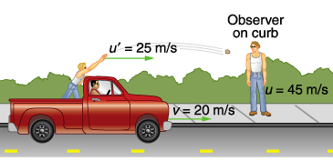
Addition of Velocities
(Non-relativistic)
Could try to reach higher velocity by throwing object from moving platform.
Works well for non-relativistic objects.

Slide 46
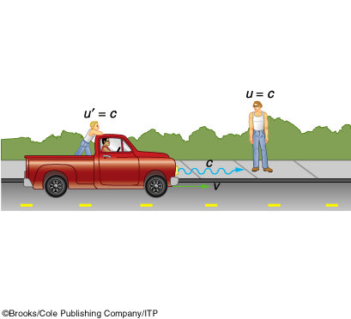
Addition of Velocities
(Relativistic)

Slide 47
Relativistic Addition of Velocities
Very low velocity: Nonrelativistic
What about intermediate velocites?
Very high velocity: Extreme relativistic

Slide 48
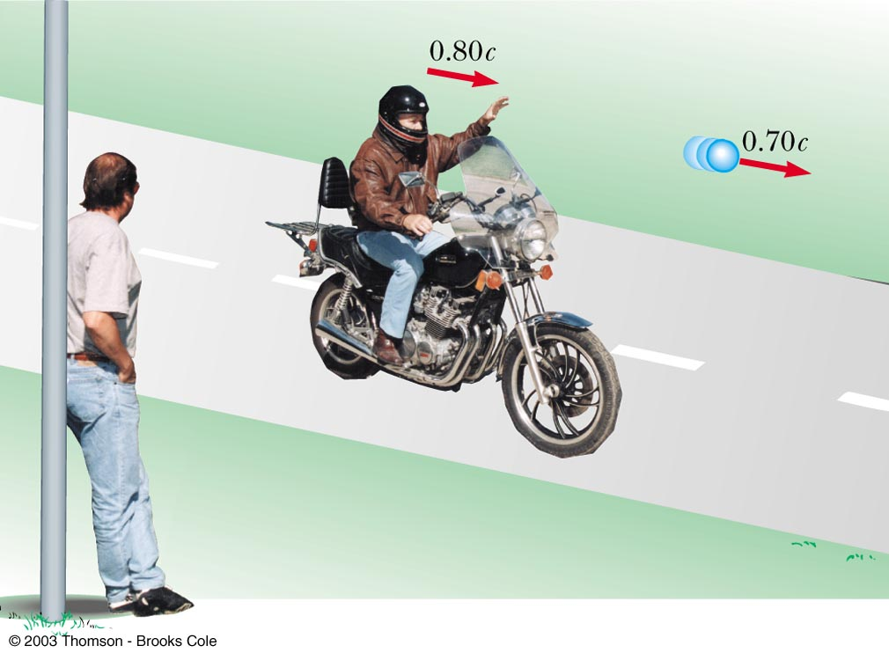
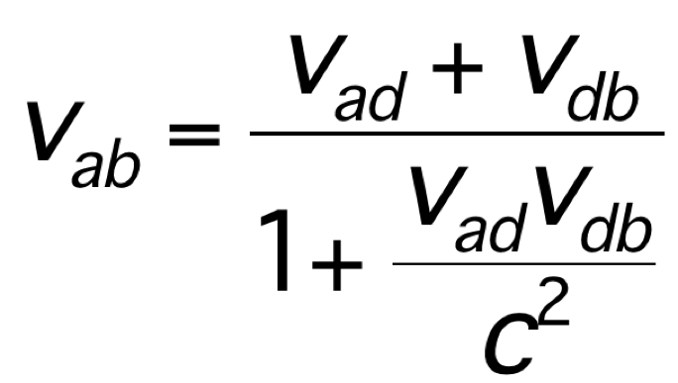
Relativistic Addition of Velocities
Galilean addition of velocities can not be applied to objects moving near the speed of light
Einstein’s modification is
The denominator is a correction based on length contraction and time dilation
v_{db}
v_{ad}
Frame d
Frame b
Object a

Slide 49
Relativistic Addition of Velocities
As motorcycle velocity approaches c,
v_{ab} also gets closer and closer to c
End result: nothing exceeds the speed of light
v_{db}
v_{ad}
Frame d
Frame b
Object a

Slide 50
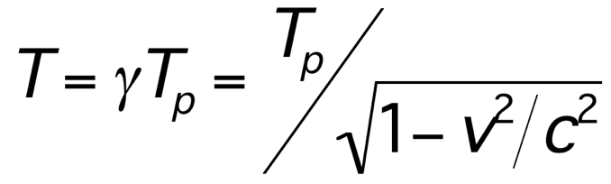
Review: Time Dilation and Length Contraction
Time in other frame
Time in object’s rest frame
Times measured in other frames are longer (time dilation)
Length in other frame
Length in object’s rest frame
Distances measured in other frames are shorter (length contraction)
Need to define the rest frame and the “other” frame which is moving with respect to the rest frame

Slide 51
Relativistic Addition of Velocities
As motorcycle velocity approaches c,
v_{ab} also gets closer and closer to c
End result: nothing exceeds the speed of light
v_{db}
v_{ad}
Frame d
Frame b
Object a

Slide 52
Observing from a new frame
In relativity these events will look different in reference frame moving at some velocity
The new reference frame can be represented as same events along different coordinate axes
ct’
New frame moving relative to original
ct
Coordinates in new frame
x’
x
Coordinates in original frame

Slide 53
A relativistic invariant quantity
Earth Frame | Ship Frame
Event separation = 4.3 LY | Event separation = 0 LY
Time interval = 4.526 yrs | Time interval = 1.413 yrs
The quantity (separation)²-c²(time interval)² is the same for all observers
It mixes the space and time coordinates

Slide 54
‘Separation’ between events
Views of the same cube from two different angles.
Distance between corners (length of red line drawn on the flat page) seems to be different depending on how we look at it.
But clearly this is just because we are not considering the full three-dimensional distance between the points.
The 3D distance does not change with viewpoint.

Slide 55
Newton again
Fundamental relations of Newtonian physics
  acceleration = (change in velocity)/(change in time)
  acceleration = Force / mass
  Work = Force x distance
  Kinetic Energy = (1/2) (mass) x (velocity)²
  Change in Kinetic Energy = net work done
Newton predicts that a constant force gives
  Constant acceleration
  Velocity proportional to time
  Kinetic energy proportional to (velocity)²

Slide 56
Forces, Work, and Energy in Relativity
What about Newton’s laws?
Relativity dramatically altered our perspective of space and time
  But clearly objects still move,
  spaceships are accelerated by thrust,
  work is done,
  energy is converted.
How do these things work in relativity?

Slide 57
Applying a constant force
Particle initially at rest,
then subject to a constant force starting at t=0,
Δmomentum =momentum = (Force) x (time)
Using momentum = (mass) x (velocity),
Velocity increases without bound as time increases
Relativity says no.
The effect of the force gets smaller and smaller
as velocity approaches speed of light

Slide 58
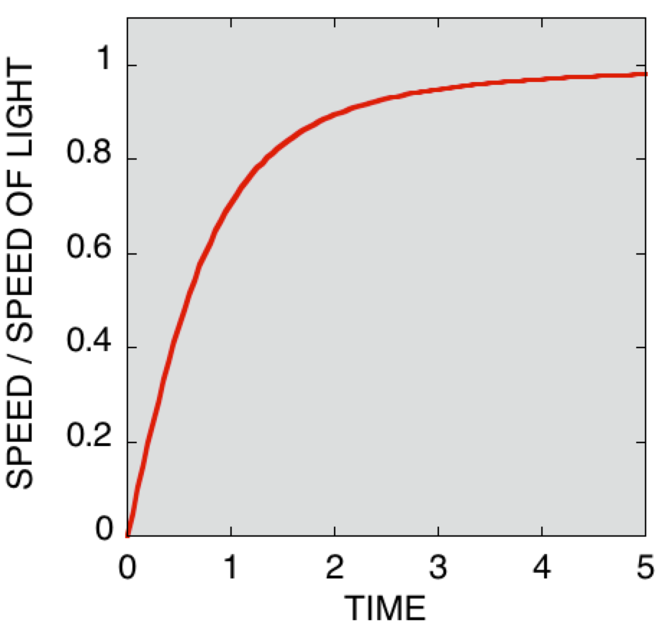
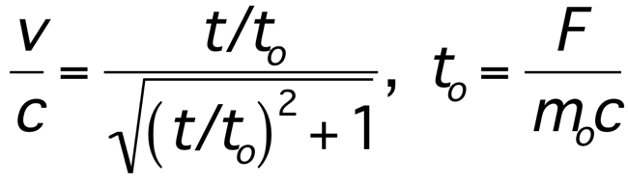
Relativistic speed of particle subject to constant force
At small velocities (short times) the motion is described by Newtonian physics
At higher velocities, big deviations!
The velocity never exceeds the speed of light
Newton
Einstein

Slide 59
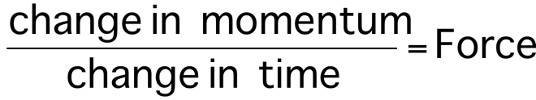
Momentum in Relativity
The relationship between momentum and force is very simple and fundamental
Momentum is constant for zero force
and
This relationship is preserved in relativity

Slide 60
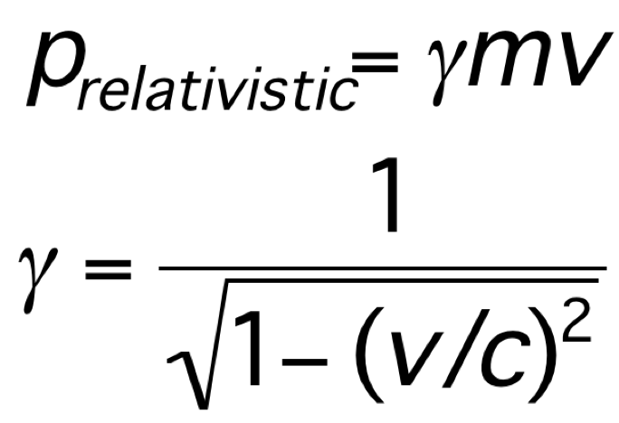
Relativistic momentum
Relativity concludes that the Newtonian definition of momentum (p_{Newton}=mv=mass x velocity)
is accurate at low velocities,
but not at high velocities
The relativistic momentum is:
Relativistic gamma
mass
velocity

Slide 61
Was Newton wrong?
Relativity requires a different concept of momentum
But not really so different!
For small velocities << light speed
γ≈1, and so p_{relativistic} ≈ mv
This is Newton’s momentum
Differences only occur at velocities that are a substantial fraction of the speed of light

Slide 62
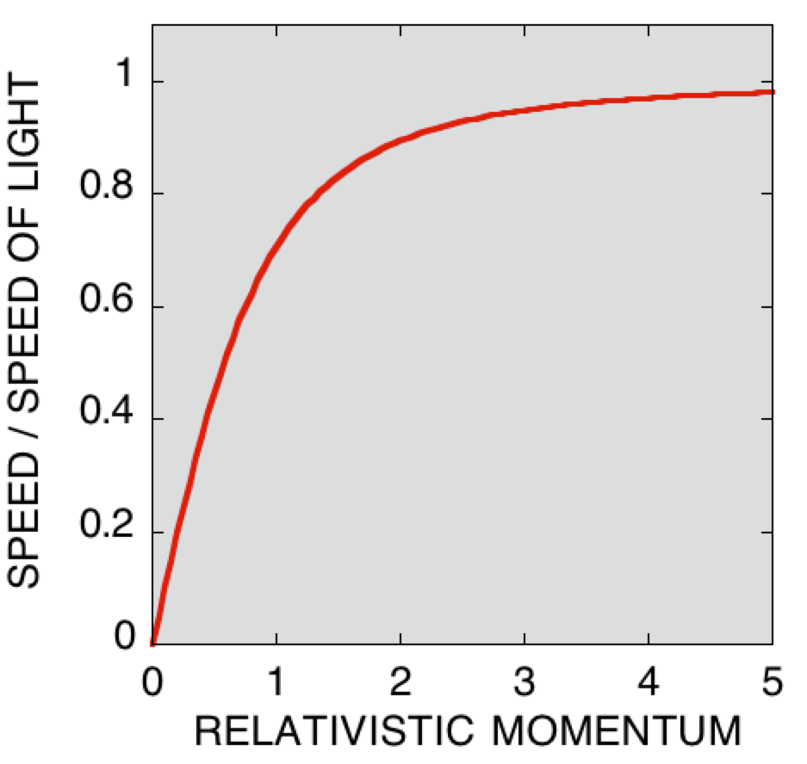
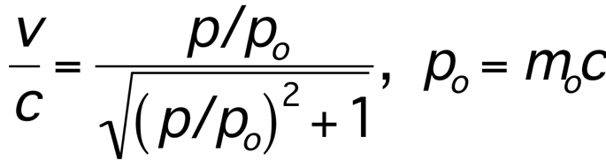
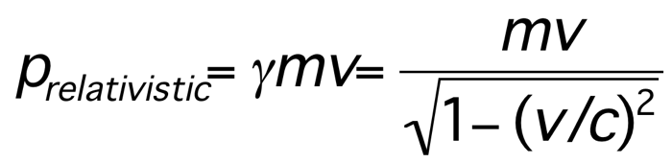
Relativistic Momentum
Momentum can be increased arbitrarily, but velocity never exceeds c
We still use
For constant force we still have
momentum = Force x time,
but the velocity never exceeds c
Momentum has been redefined
Newton’s momentum
Relativistic momentum for different speeds.

Slide 63
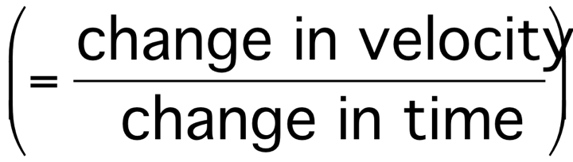
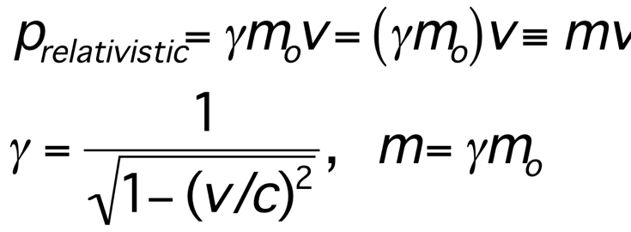
How can we understand this?
acceleration
much smaller at high speeds than at low speeds
Newton said force and acceleration related by mass.
We could say that mass increases as speed increases.
Can write this
m_{o} is the rest mass.
relativistic mass m depends on velocity

Slide 64
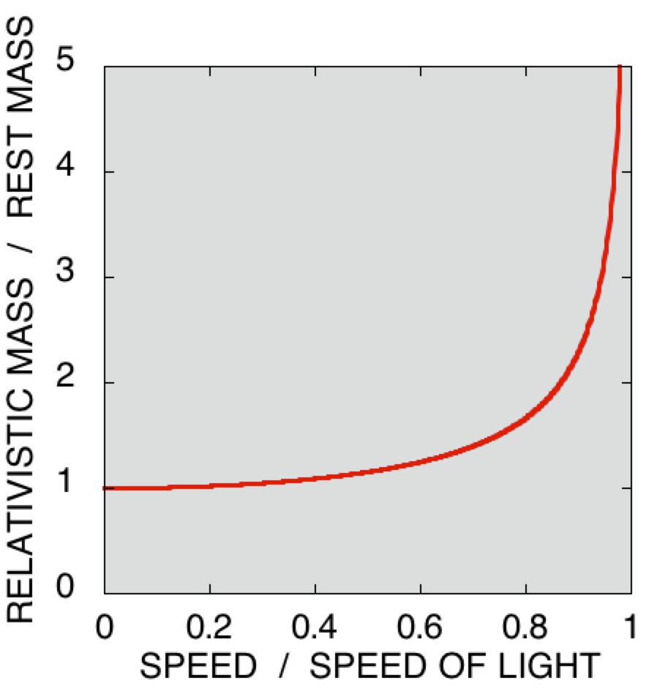
Relativistic mass
The the particle becomes extremely massive as speed increases ( m=γm_{o} )
The relativistic momentum has new form ( p= γm_{o}v )
Useful way of thinking of things remembering the concept of inertia

Slide 65
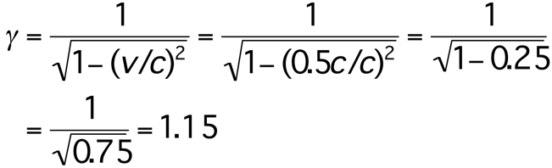
Example
An object moving at half the speed of light relative to a particular observer has a rest mass of 1 kg. What is it’s mass measured by the observer?
So measured mass is 1.15kg

Slide 66
Question
A object of rest mass of 1 kg is moving at 99.5% of the speed of light.
What is it’s measured mass?
A. 10 kg
B. 1.5 kg
C. 0.1 kg

Slide 67
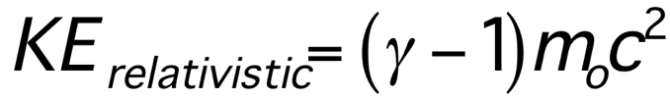
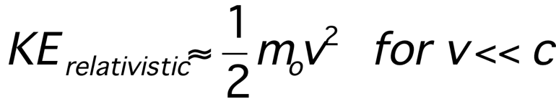
Relativistic Kinetic Energy
Might expect this to change in relativity.
Can do the same analysis as we did with Newtonian motion to find
Doesn’t seem to resemble Newton’s result at all
However for small velocities, it does reduce to the Newtonian form

Slide 68
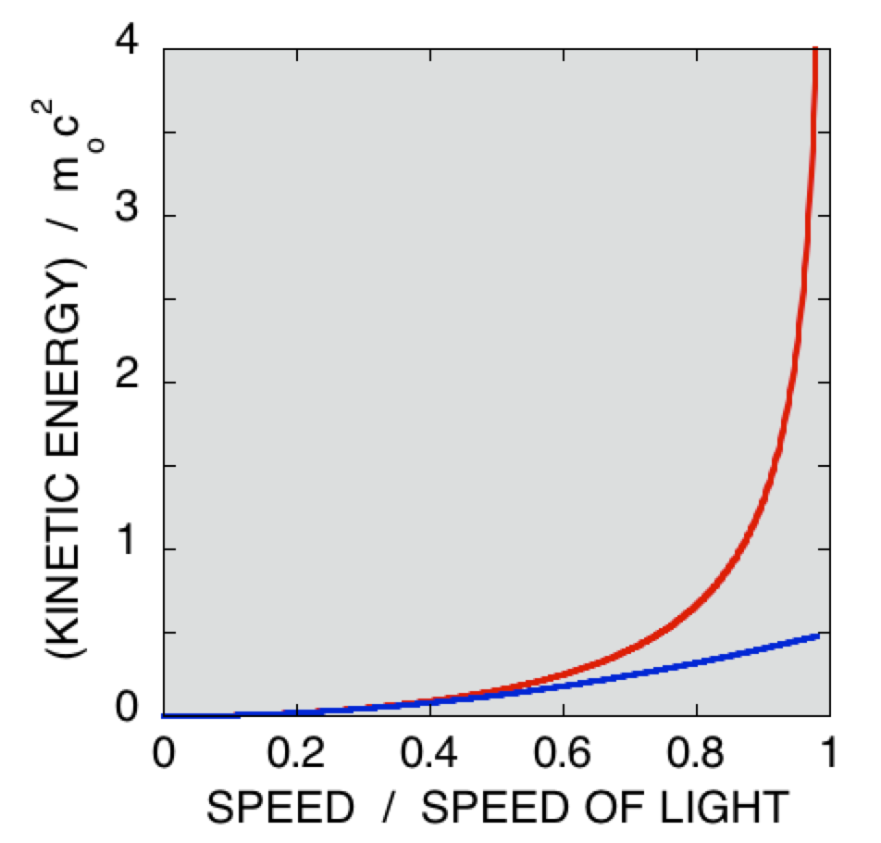
Relativistic Kinetic Energy
Can see this graphically as with the other relativistic quantities
Kinetic energy gets arbitrarily large as speed approaches speed of light
Is the same as Newtonian kinetic energy for small speeds.
Relativistic
Newton

Slide 69
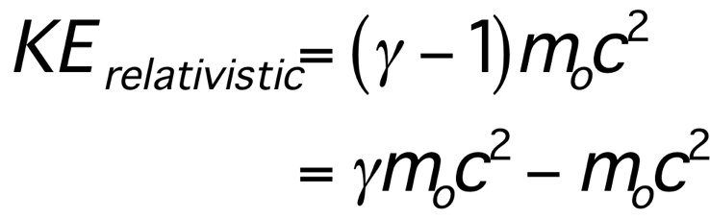

Total Relativistic Energy
The relativistic kinetic energy is
Depends on velocity
Constant, independent of velocity
Write this as
Total energy
Rest energy
Kinetic energy

Slide 70

Mass-energy equivalence
This results in Einstein’s famous relation
This says that the total energy of a particle
is related to its mass.
Even when the particle is not moving it has energy.
We could also say that mass is another form of energy
  Just as we talk of chemical energy, gravitational energy, etc, we can talk of mass energy

Slide 71
Example
In a frame where the particle is at rest,
its total energy is E = m_{o}c²
Just as we can convert electrical energy to mechanical energy, it is possible to tap mass energy
A 1 kg mass has (1kg)(3x10⁸m/s⁾²=9x10¹⁶ J of energy
  We could power
  30 million 100 W light bulbs for one year!
  (~30 million sec in 1 yr)

Slide 72
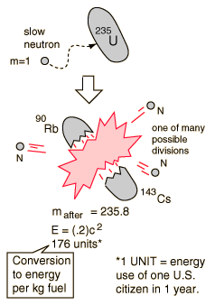
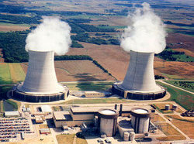
Nuclear Power
Doesn’t convert whole protons or neutrons to energy
Extracts some of the binding energy of the nucleus
  ⁹⁰Rb and ¹⁴³Cs + 3n have less rest mass than ²³⁵U +1n: E = mc²

Slide 73
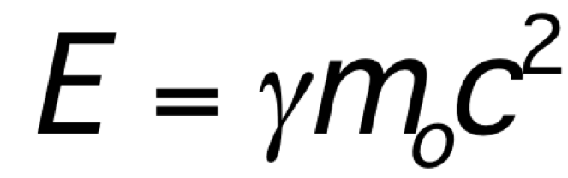
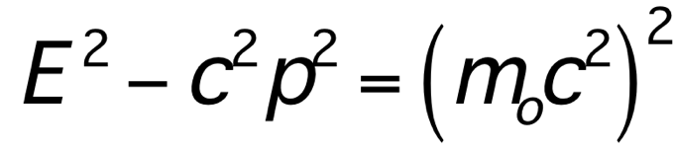
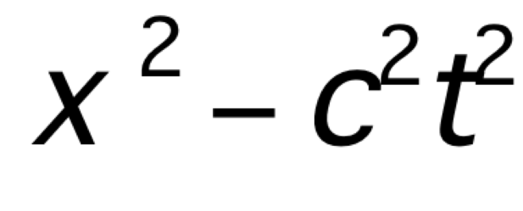
Energy and momentum
Relativistic energy is
Since γ depends on velocity, the energy is measured to be different by different observers
Momentum also different for different observers
  Can think of these as analogous to space and time, which individually are measured to be different by different observers
But there is something that is the same for all observers:
Compare this to our space-time invariant
= Square of rest energy

Slide 74
A relativistic perspective
The concepts of space, time, momentum, energy
that were useful to us at low speeds for Newtonian dynamics are a little confusing near light speed
Relativity needs new conceptual quantities,
such as space-time and energy-momentum
Trying to make sense of relativity using space and time separately leads to effects such as time dilation and length contraction
In the mathematical treatment of relativity, space-time and energy-momentum objects are always considered together

Slide 75

The Equivalence Principle
Clip from Einstein Nova special
Led Einstein to postulate the
Equivalence Principle

Slide 76

Equivalence principle
Accelerating reference frames are indistinguishable from a gravitational force

Slide 77


Try some experiments
Constant accel.
Constant velocity
t=0
t=t_{o}
t=2t_{o}
t=0
t=t_{o}
t=2t_{o}
Floor accelerates upward to meet ball
Cannot do any experiment to distinguish accelerating frame from gravitational field

Slide 78
Light follows the same path
Velocity = v+2at_{o}
Path of light beam in our frame
Velocity = v+at_{o}
Velocity = v
Path of light beam in accelerating frame
t=0
t=t_{o}
t=2t_{o}

Slide 79
Is light bent by gravity?
If we can’t distinguish an accelerating reference frame from gravity…
and light bends in an accelerating reference frame…
then light must bend in a gravitational field
But light doesn’t have any mass.
How can gravity affect light?
Maybe we are confused
about what a straight line is

Slide 80

Which of these is a straight line?
A
B
C
A
B
C
All of them

Slide 81
Straight is shortest distance
They are the shortest distances determined by wrapping string around a globe. On a globe, they are called ‘great circles’. In general, geodesics.
This can be a general definition of straight,
and is in fact an intuitive one on curved surfaces
It is the one Einstein used for the path of all objects in curved space-time
The confusion comes in when you don’t know you are on a curved surface.

Slide 82

Mass and curvature
General relativity says that any mass will give space-time a curvature
Motion of objects in space-time is determined by that curvature
Similar distortions to those we saw when we tried to draw graphs in special relativity

Slide 83

Idea behind geometric theory
Matter bends space and time.
Bending on a two-dimensional surface is characterized by curvature at each point
curvature = 1/(radius of curvature)²
How can we relate curvature to matter?

Slide 84

Einstein’s solution
Einstein guessed that the curvature functions (units of 1/m²)
are proportional to
the local energy and momentum densities
(units of kg/m³)
The proportionality constant from comparison with Newtonian theory is
where G is Newton's constant

Slide 85
Near the Earth
The ratio of the curvature of space on the surface of the Earth to the curvature of the surface of the Earth is
~ 7x10⁻¹⁰
The curvature of space near Earth is so small as to be usually unnoticeable.
But is does make objects accelerate toward the earth!

Slide 86
A test of General Relativity
Can test to see if the path of light appears curved to us
Local massive object is the sun
Can observe apparent position of stars with and without the sun
But need to block glare from sun

Slide 87




Eddington and the Total Eclipse of 1919
Apparent position of star
Measure this angle to be about 1.75 arcseconds
Actual position of star

Slide 88

Eddington’s Eclipse Expedition 1919
Eddington, British astronomer, went to Principe Island in the Gulf of Guinea to observe solar eclipse.
After months of drought, it was pouring rain on the day of the eclipse
Clouds parted just in time, they took photographic plates showing the location of stars near the sun.
Analysis of the photographs back in the UK produced a deflection in agreement with the GR prediction

